Slide 1
Numerical Optimization
Physics 113
02/24/22
Algorithms for Optimization M J Kochenderfer, T A Wheeler
https://algorithmsbook.com/optimization/ Stanford AA222

Slide 2
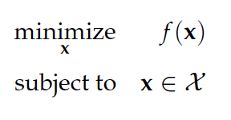
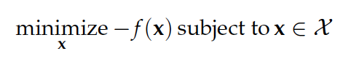
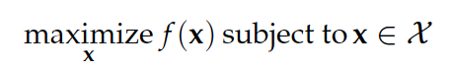
What is it?
Finding the extremal value of a function.
Finding the ’best’ (optimal) value for a set of design parameters.
Notes:
Scalar output, vector input

Slide 3
Why is it useful?
Ubiquitous in the physical sciences:
Model Fitting
Experiment Design
Minimum energy states (Euler-Lagrange)
Machine Learning!
Engineering, finance, economics….

Slide 4
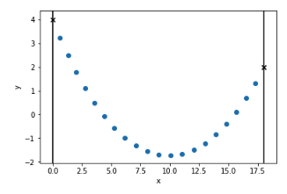
Some concrete examples
Classical Mechanics -- Shape of chain of hanging masses:

Slide 5
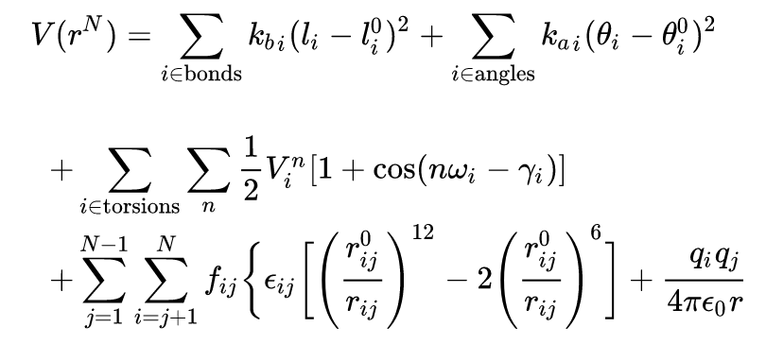
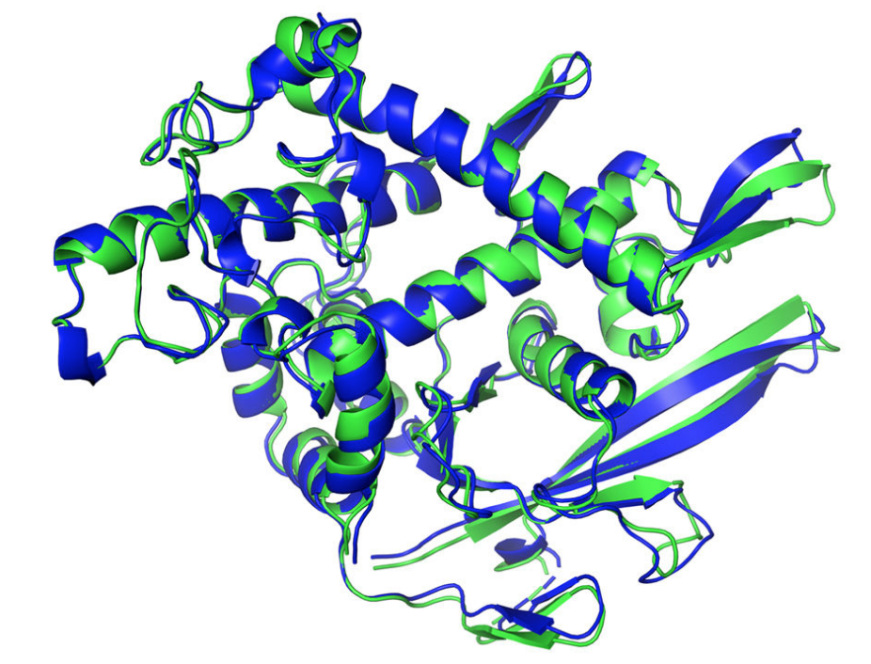
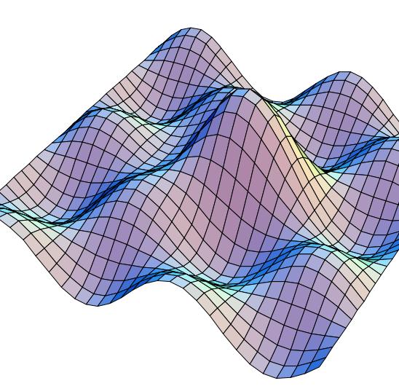
Biophysics
Biophysics -- Ground state equilibrium geometry for molecules and proteins. (AMBER)

Slide 6
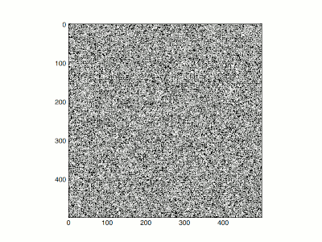
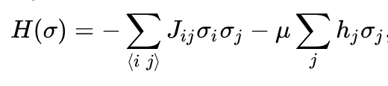
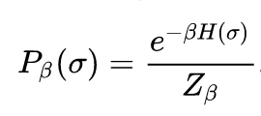
Ising model
Ferromagnets, spin glasses, neuroscience
Best approached with stochastic optimization methods like MCMC

Slide 7
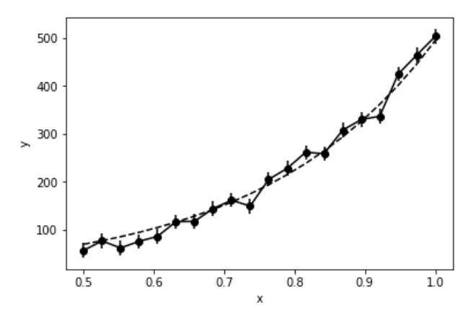
Model fitting
Dataset and any model f.
Minimize sum of model residuals:
Only analytical solution for linear models.
Neural Networks famously non-linear.

Slide 8
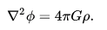
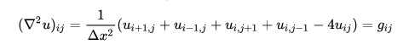
Partial Differential Equations
Relaxation methods for boundary value problems (Gravity, electrodynamics, fluid dynamics)
Solving systems of linear equations

Slide 9
Outline
Conditions for optimality
Derivatives and Numerical differentiation
1D Optimization and root finding
Multi-dimensional Optimization
First order (gradient) Based methods
Second order methods

Slide 10
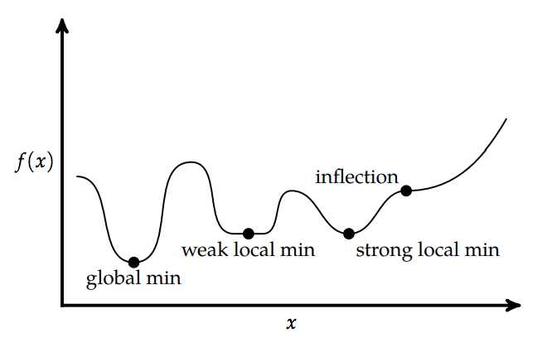
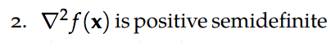
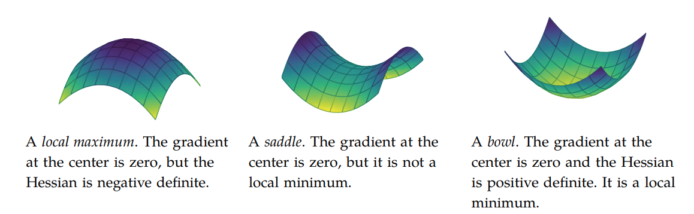
Conditions for Optimality
(SONC)
Notes:
Can see this from taylor expansion

Slide 11
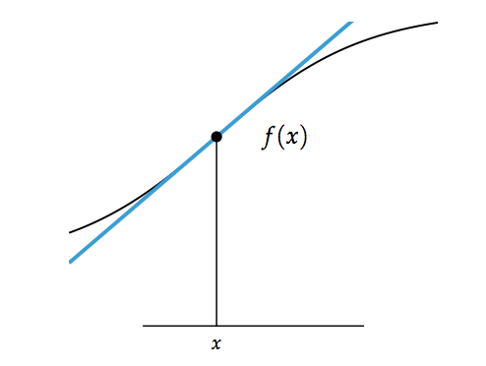
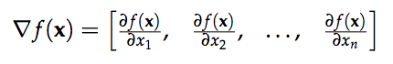
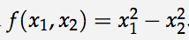
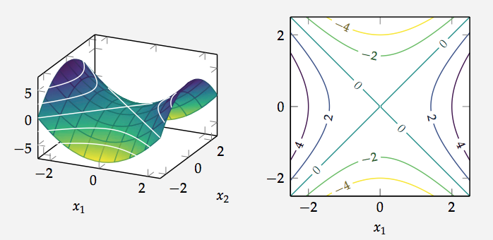
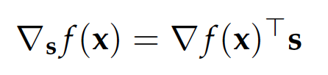
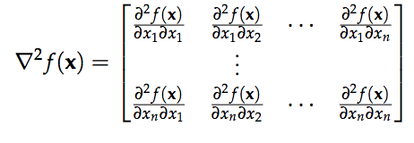
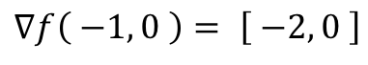
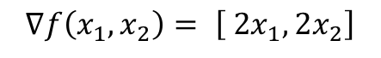
Important Aside: Derivatives
First Order Approximation.
Gradient
Directional Derivative
Hessian
$$∇f\left(x_{1},x_{2}\right)= \left[ 2x_{1}, 2x_{2}\right]$$
$$∇f\left( −1, 0 \right)= \left[ −2, 0 \right]$$

Slide 12
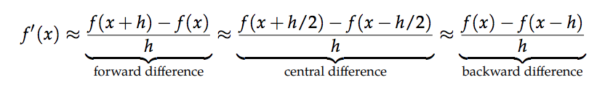
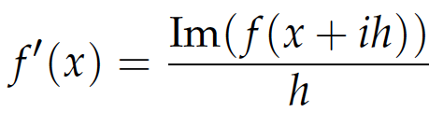
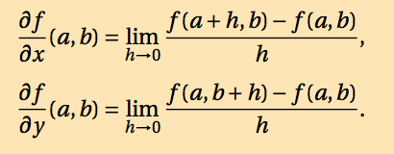
Numerical Differentiation
When the gradient isn’t available directly, we can often approximate it quite well using function evaluations.
For multivariate functions:
Complex Step method

Slide 13
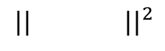
Connection: Optimization and Root finding
Root Finding
Optimization
$$|| ||^{2}$$
Notes:
Equivalent problem, similar methods

Slide 14
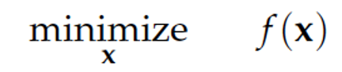
Single Variable (1D) Optimization
Scalar function of scalar variable.
Minimizing non-analytic functions
Solving transcendental equations
Sub-problem for multivariate optimization

Slide 15
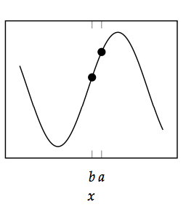
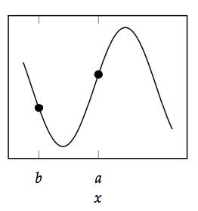
Bracketing
Bracketing is the process of identifying an interval in which a local minimum lies and then successively shrinking the interval.

Slide 16
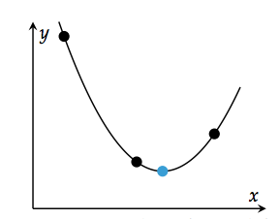
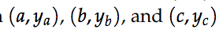
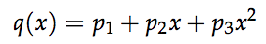
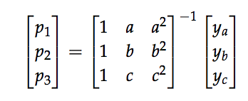
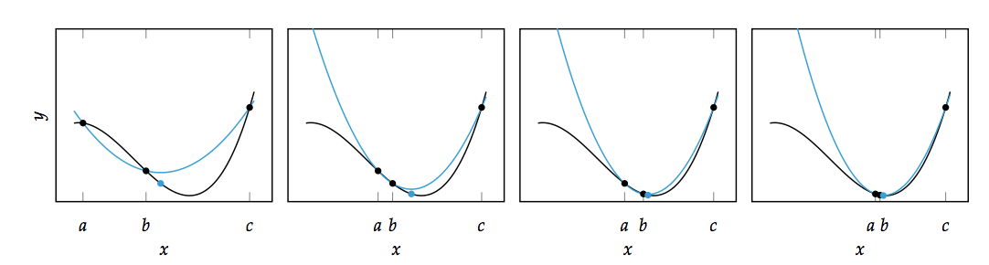
Method 1: Quadratic Fit Search

Slide 17
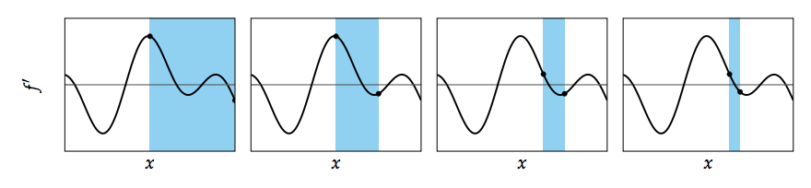
Method 2: Bisection Method
Works for both root finding and optimization.
Identify interval [a,b] that contains minimum. (i.e. identify interval with f’(a) < 0 and f’(b) > 0 ).
Take midpoint (a+b)/2.
Identify new interval that contains minimum, e.g. [(a+b)/2, b].
Repeat until convergence.
Notes:
Converges in log(n) time

Slide 18
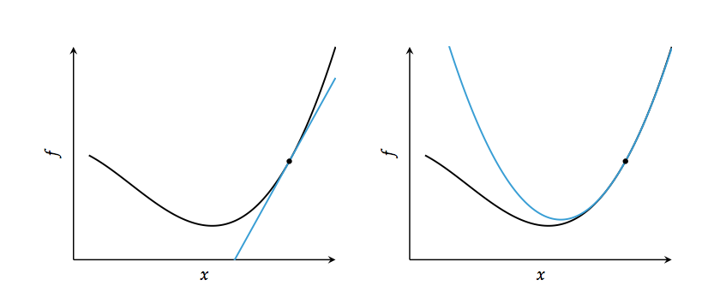
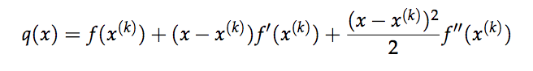
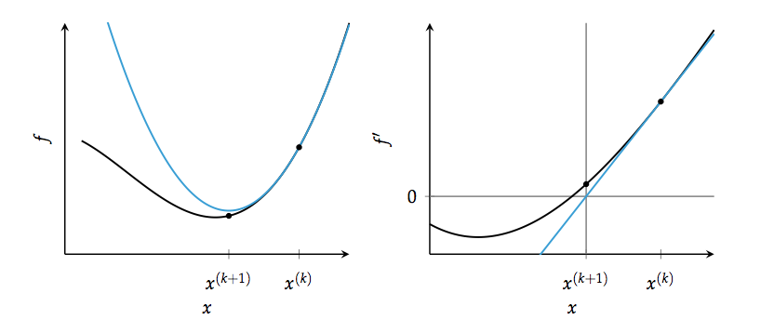
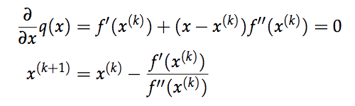
Method 3: Newton’s Method
Works for both root finding and optimization.

Slide 19
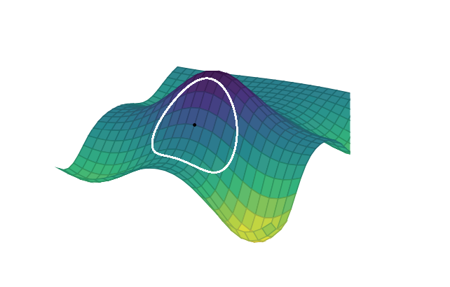
Multivariate Optimization: Local Descent
Scalar function of a vector variable
In multivariate problems, we incrementally improve our design point x by taking a step that minimizes an approximation of f(x) based on local information.
Notes:
What local information do we have about a function?

Slide 20
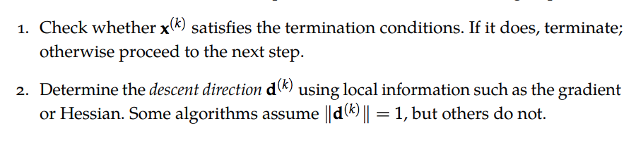
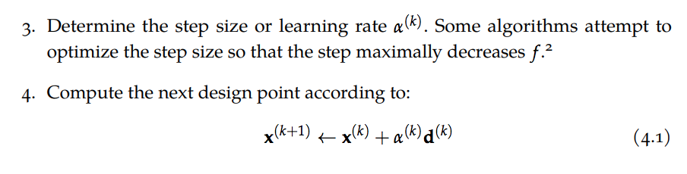
Iterative descent procedure

Slide 21
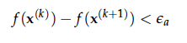
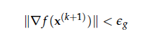
Checking for convergence/stopping
Terminate after fixed number of steps.
If function change small, then terminate.
If norm of the gradient small, terminate.

Slide 22
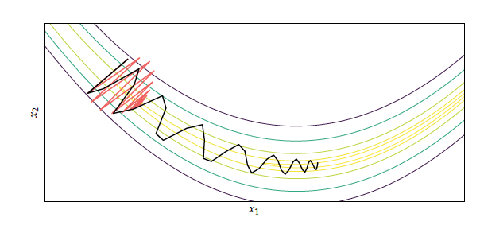
Which direction to take?
Negative gradient -> Direction of maximum decrease of your function.
Negative Gradient not always the best direction:
Some alternatives:
Conjugate gradient
Noisy gradient
Gradient with Momentum

Slide 23
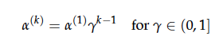
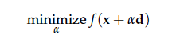
How big a Step?
Decaying step size
Line Search

Slide 24
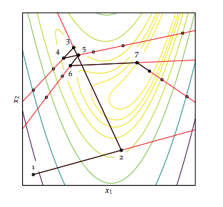


Line Search
Generally expensive to solve fully -> Use approximate
Line search.

Slide 25



First Order methods 1: Gradient Descent
First order methods use gradient information at each step.
Gradient descent
Jagged steps -> gets stuck in valleys.
Neural networks use stochastic gradient descent
-> less likely to get stuck

Slide 26

Method 2: Gradient Descent with Momentum
Keeps momentum along previous direction steps:
Less likely to get stuck in valleys

Slide 27






Method 3: Conjugate Gradient Method
Originally for minimizing quadratic functions / solving systems of linear equations
Modified for general optimization:

Slide 28


Second Order Methods 1: Newton’s Method
Second order methods use gradient and hessian (first and second derivative information at each point).
Newton’s method: Extension of 1D method
Quadratic Convergence: Converges very fast if function bowl shaped.
Inverting Hessian can be expensive.

Slide 29

Newton Failures
Can be adjusted to include line search and/or step size to avoid these failures

Slide 30






Method 2: Quasi Newton Methods (DFP, BFGS)
If we don’t know Hessian or it is too expensive to compute, we can approximate it numerically:
1D

Slide 31

Direct Methods (0th order)
Can use methods mentioned so far and just approximate gradient numerically.
There do exist specialized methods that only use function information (no gradient).
Nelder-Mead Simplex:

Slide 32

Scipy.optimize.minimize()

